Slide 1
Parkinson's Disease Predictive Machine Learning Model
Luna Pérez Troncoso

Slide 2
Introduction
The early detection of PD is a growing priority within both clinical practice and research.

Slide 3
Introduction
The early detection of PD is a growing priority within both clinical practice and research.
Many individuals remain undiagnosed until the disease has already progressed, limiting the effectiveness of available therapeutic interventions.

Slide 4
Introduction
The early detection of PD is a growing priority within both clinical practice and research.
Many individuals remain undiagnosed until the disease has already progressed, limiting the effectiveness of available therapeutic interventions. Consequently, timely diagnosis can significantly influence patient outcomes and long-term quality of life.

Slide 5
Introduction
The early detection of PD is a growing priority within both clinical practice and research.
Many individuals remain undiagnosed until the disease has already progressed, limiting the effectiveness of available therapeutic interventions. Consequently, timely diagnosis can significantly influence patient outcomes and long-term quality of life.
Early identification could allow for timelier monitoring, lifestyle adjustments, and targeted therapeutic strategies that may slow disease progression or improve quality of life.

Slide 6
Why develop a predictive model?
01
A reliable predictive system has the potential to support clinicians in recognizing subtle signs that might otherwise go unnoticed.

Slide 7
Why develop a predictive model?
01
A reliable predictive system has the potential to support clinicians in recognizing subtle signs that might otherwise go unnoticed.

Slide 8
Why develop a predictive model?
01
A reliable predictive system has the potential to support clinicians in recognizing subtle signs that might otherwise go unnoticed.
Predictive modeling can help researchers gain deeper insight into the complex interactions that contribute to the onset of neurodegenerative disorders
02

Slide 9
Why develop a predictive model?
01
A reliable predictive system has the potential to support clinicians in recognizing subtle signs that might otherwise go unnoticed.
Predictive modeling can help researchers gain deeper insight into the complex interactions that contribute to the onset of neurodegenerative disorders
02

Slide 10
Why develop a predictive model?
01
A reliable predictive system has the potential to support clinicians in recognizing subtle signs that might otherwise go unnoticed.
Predictive modeling can help researchers gain deeper insight into the complex interactions that contribute to the onset of neurodegenerative disorders
02
Beyond clinical impact, creating a predictive model encourages the integration of modern data-driven approaches into neurological healthcare, which stands out as a promising path to more personalized and proactive patient care.
03

Slide 11
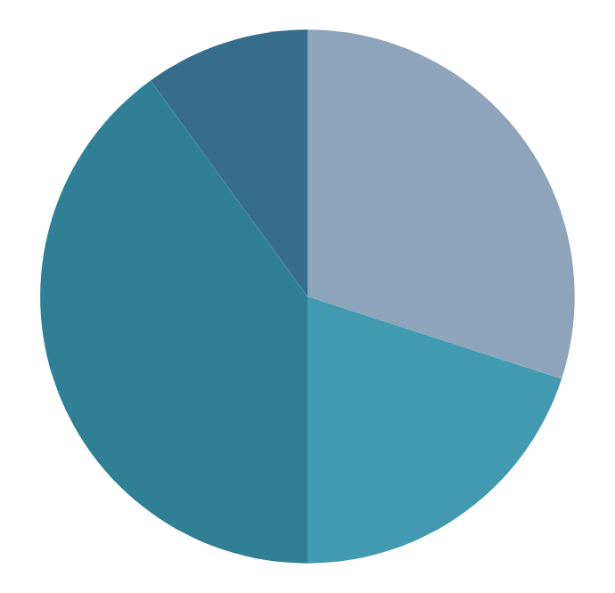
Objective
Integrating diverse variables (demographic, lifestyle, clinical, cognitive, and symptom-related variables) into a unified predictive framework, the project seeks to evaluate multiple machine learning algorithms and determine their capability to accurately identify patients at risk.

Slide 12
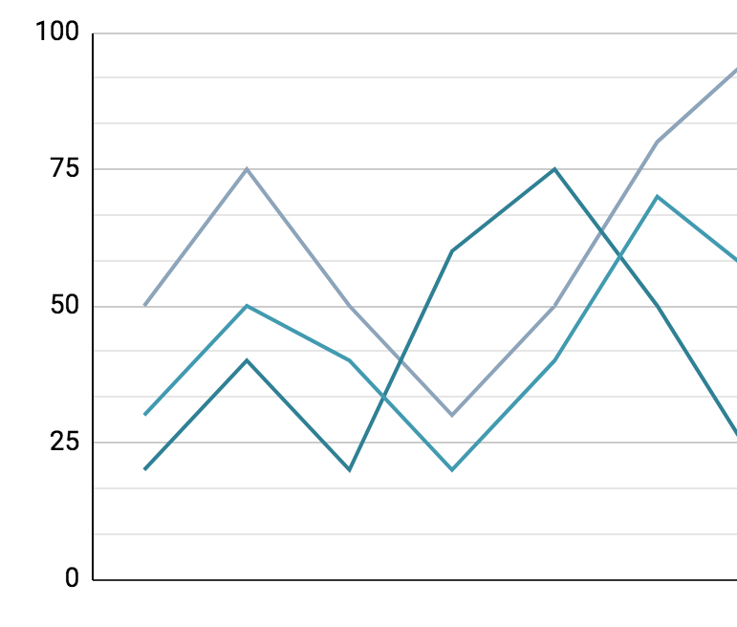
Data Description and Sources
As part of this project, I selected a synthetic dataset from Kaggle generated by Mr. Rabie El Kharoua, to support the development of a predictive model for Parkinson’s disease.

Slide 13
Data Description and Sources
As part of this project, I selected a synthetic dataset from Kaggle generated by Mr. Rabie El Kharoua, to support the development of a predictive model for Parkinson’s disease.
This dataset contains diverse features:

Slide 14
Data Description and Sources
As part of this project, I selected a synthetic dataset from Kaggle generated by Mr. Rabie El Kharoua, to support the development of a predictive model for Parkinson’s disease.
This dataset contains diverse features:
Demographic variables (age, gender, ethnicity, educational level).

Slide 15
Data Description and Sources
As part of this project, I selected a synthetic dataset from Kaggle generated by Mr. Rabie El Kharoua, to support the development of a predictive model for Parkinson’s disease.
This dataset contains diverse features:
Demographic variables (age, gender, ethnicity, educational level).
Lifestyle Factors (BMI, smoking, alcohol, physical activity, diet and sleep quality).

Slide 16
Data Description and Sources
As part of this project, I selected a synthetic dataset from Kaggle generated by Mr. Rabie El Kharoua, to support the development of a predictive model for Parkinson’s disease.
This dataset contains diverse features:
Demographic variables (age, gender, ethnicity, educational level).
Lifestyle Factors (BMI, smoking, alcohol, physical activity, diet and sleep quality).
Medical History (TBI, Depression, Stroke, Diabetes…)

Slide 17
Data Description and Sources
As part of this project, I selected a synthetic dataset from Kaggle generated by Mr. Rabie El Kharoua, to support the development of a predictive model for Parkinson’s disease.
This dataset contains diverse features:
Demographic variables (age, gender, ethnicity, educational level).
Lifestyle Factors (BMI, smoking, alcohol, physical activity, diet and sleep quality).
Medical History (TBI, Depression, Stroke, Diabetes…)
Clinical Meassurements(Cholesterol, Triglycerides, BP).

Slide 18
Data Description and Sources
As part of this project, I selected a synthetic dataset from Kaggle generated by Mr. Rabie El Kharoua, to support the development of a predictive model for Parkinson’s disease.
This dataset contains diverse features:
Demographic variables (age, gender, ethnicity, educational level).
Lifestyle Factors (BMI, smoking, alcohol, physical activity, diet and sleep quality).
Medical History (TBI, Depression, Stroke, Diabetes…)
Clinical Meassurements(Cholesterol, Triglycerides, BP).
Cognitive and Functional Assessments (UPDRS, MoCA…).

Slide 19
Data Description and Sources
As part of this project, I selected a synthetic dataset from Kaggle generated by Mr. Rabie El Kharoua, to support the development of a predictive model for Parkinson’s disease.
This dataset contains diverse features:
Demographic variables (age, gender, ethnicity, educational level).
Lifestyle Factors (BMI, smoking, alcohol, physical activity, diet and sleep quality).
Medical History (TBI, Depression, Stroke, Diabetes…)
Clinical Meassurements(Cholesterol, Triglycerides, BP).
Cognitive and Functional Assessments (UPDRS, MoCA…).
Symptom indicators (Tremor, Constipation, Rigidity).

Slide 20
RESULTS: Final Models
In this project two reliable predictive models with subtle differences were developed

Slide 21
RESULTS: Final Models
In this project two reliable predictive models with subtle differences were developed
01
MODEL 1
Maximizes correct predictions

Slide 22
RESULTS: Final Models
In this project two reliable predictive models with subtle differences were developed
01
02
MODEL 1
MODEL 2
Maximizes correct predictions
Maximazes Parkinson’s Disease patients detection

Slide 23
MODEL 1: Test Results
01

Slide 24
MODEL 1: Test Results
01
96.9%
This model predicted correctly 408 of 421 patients’ diagnosis

Slide 25
MODEL 1: Test Results
01
96.9%
95.7%
This model predicted correctly 408 of 421 patients’ diagnosis
155 of 162 of the heatlhy patients were diagnosed as healthy.

Slide 26
MODEL 1: Test Results
01
96.9%
95.7%
97.7%
This model predicted correctly 408 of 421 patients’ diagnosis
155 of 162 of the heatlhy patients were diagnosed as healthy.
253 of 259 Parkinson’s Disease patients were detected

Slide 27
MODEL 2: Test Results
01
02

Slide 28
MODEL 2: Test Results
01
02
96.4%
This model predicted correctly 406 of 421 patients’ diagnosis

Slide 29
MODEL 2: Test Results
01
02
96.4%
93.8%
This model predicted correctly 406 of 421 patients’ diagnosis
152 of 162 of the heatlhy patients were diagnosed as healthy.

Slide 30
MODEL 2: Test Results
01
02
96.4%
93.8%
98.1%
This model predicted correctly 406 of 421 patients’ diagnosis
152 of 162 of the heatlhy patients were diagnosed as healthy.
254 of 259 Parkinson’s Disease patients were detected

Slide 31
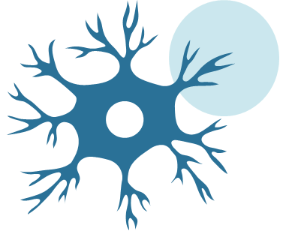
Conclusions

Slide 32
Conclusions
Two machine learning predictive models with impresive performance were developed sucessfully.

Slide 33
Conclusions
Two machine learning predictive models with impresive performance were developed sucessfully.
These models can support clinicians in recognizing subtle signs that might otherwise go unnoticed, gain deeper insight into the complex interactions that contribute to neurodegenerative disorders and reach more personalized and proactive patient care.

Slide 34
Conclusions
Two machine learning predictive models with impresive performance were developed sucessfully.
These models can support clinicians in recognizing subtle signs that might otherwise go unnoticed, gain deeper insight into the complex interactions that contribute to neurodegenerative disorders and reach more personalized and proactive patient care.
Timely diagnosis will improve the effectiveness of available therapeutic interventions, influencing patient outcomes and long-term quality of life.

Slide 35
Strenghs and Limitations
Stenghs
Predictive models detected the majority of the Parkinson’s Disease Patients. Components of the model are scalable and fast-performing, allowing fast prediction of huge datasets in seconds. Models has great flexibility. Consequently it can be adjusted and re-trained with new data with training times of less than one minute in train dataset of 2000 registers.

Slide 36
Strenghs and Limitations
Stenghs
Predictive models detected the majority of the Parkinson’s Disease Patients. Components of the model are scalable and fast-performing, allowing fast prediction of huge datasets in seconds. Models has great flexibility. Consequently it can be adjusted and re-trained with new data with training times of less than one minute in train dataset of 2000 registers.
Limitations
Although the models detected the majority of the Parkinson’s Disease Patients, sometimes healthy patients are diagnosed with Parkinson’s Disease. The model has not been tested in datasets with missing information.

Slide 37




THANKS FOR YOUR ATTENTION
Github Repository
Streamlit Webpage

